Slide 1
COP4020 – Programming Languages
Rule-based Programming Languages: Prolog

Slide 2
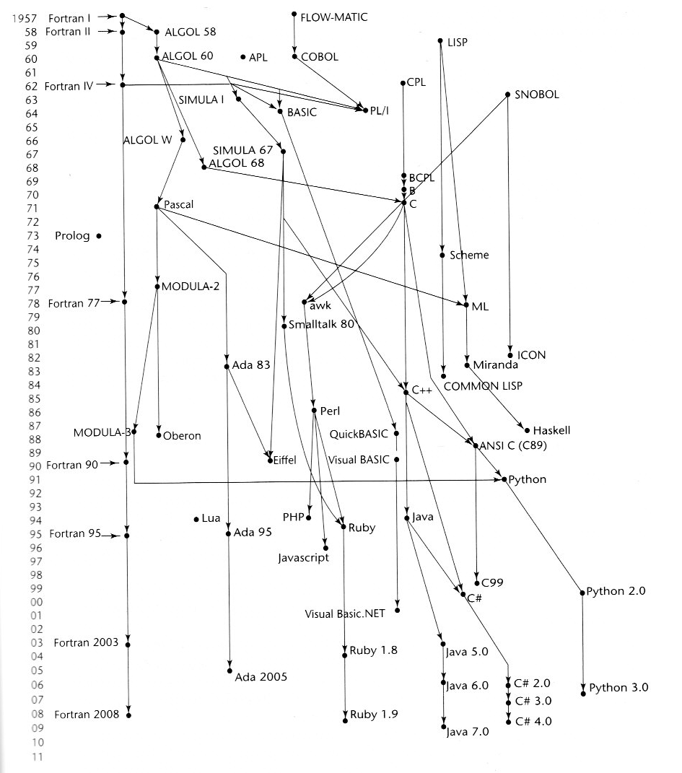

Slide 3
Symbolic Logic
Logic programming
  Idea: applying deduction methods to execute a program
Programs are expressed in the form of propositions that assert facts and relationships about which one might wish to reason
Theorem provers evaluate the facts and rules in an attempt to prove or disprove an assertion
Prolog uses Symbolic Logic
  Early 1970s, Alain Colmerauer, Phillippe Roussel and colleagues at the University of Marseilles developed Prolog
  Prolog was an important early language for AI

Slide 4
Predicate Calculus
Proposition – a logical statement that may or may not be true
Symbolic Logic – can be used for three basic needs in formal logic. To express:
  Propositions
  Relationships among propositions
  How new propositions can be inferred from other propositions that are assumed to be true.
Atomic propositions – the simplest type of proposition. They are composed of:
  A functor
  An ordered list of parameters or arguments
  man(jake)
  likes(bob, steak)

Slide 5
Predicate Calculus
Compound Propositions – have two or more atomic propositions connected with logical operators
Precedence of the operators:
Name | Symbol | Example | Meaning
Negation | ¬ | ¬ a | not a
Conjunction | ∧ or ∩ | a ∩ b | a and b
Disjunction | ∨ or ∪ | A ∪ b | a or b
Equivalence | ≡ |  | a eqiv b
implication | ⊃ ⊂ | a ⊃ b a ⊂ b | a implies b b implies a
Name | Symbol
highest | ¬
 | ∩ ∪ ≡
lowest | ⊃ ⊂

Slide 6
Predicate Calculus
Existential and Universal quantifiers
Existential quantifier "there exists" Symbol: ∃
Universal quantifier "for all" Symbol: ∀
    ∀ X.(woman(X) ⊃ human(X))
    ∃ X.(mother(mary, X) ∩ male(X))
Clausal form (simplifies the predicate calculus to reduce redundant ways to express things) is comprised of:
  Antecedents – the right side of a clause; preconditions for the clause to be true or false
  Consequents – the consequence of the truth of the antecedents
likes(bob, trout) ⊂ likes(fish, bob) ∩
fish(trout)

Slide 7
Clausal Form
Clauses have the following general form
B ⊂ A₁ ∩ A₂ ∩ … ∩ A_{m}
Because of this form:
  Existential quantifiers are not required
  Universal quantifiers are implicit in the use of variables in the atomic propositions
  No operators other than conjunction and disjunction are required
Horn Clause: A special type of clause with either:
  A single atomic proposition on the LHS (the clause is an inference rule)
  No proposition on the LHS (the clause comprises a fact)

Slide 8
Prolog
Prolog
  Goal is to be non-procedural, relational
  Write down facts and rules, then ask questions
Relations and predicates
  Data can be viewed as a set of
    logical statements about truth
    relationships defined between data objects
Relational databases have substantial similarities to Prolog
  Prolog takes a logical point of view
  Databases take a relational point of view
SWI Prolog tutorial
Some Prolog Example Programs
Prolog Lists

Slide 9
Prolog
Given a family tree, one can represent it by the following declarative statements:
  Alice is the mother of Jeffrey
  Alice is the mother of George
  Sue is the mother of Mary
  Mary is the mother of Cindy
  Mary is the mother of Victor
  Albert is the father of Jeffrey
  Albert is the father of George
  John is the father of Mary
  George is the father of Cindy
  George is the father of Victor

Slide 10
Prolog
The preceding statements are equivalent to the following data structure:
The structures FatherOf and MotherOf are relations. They define relationships between objects. In this case, the objects are people.
Alice
Albert
John
Sue
FatherOf
MotherOf
MotherOf
FatherOf
FatherOf
MotherOf
Jeffrey
George
Mary
MotherOf
FatherOf
MotherOf
FatherOf
Victor
Cindy

Slide 11
Prolog
The relationships could also be presented in a table. In this case, each tuple in the table is an instance of the relation:
  FatherOf
    Albert, Jeffrey
    Albert, George
    John, Mary
    George, Cindy
    George, Victor
  MotherOf
    Alice, Jeffrey
    Alice, George
    Sue, Mary
    Mary, Cindy
    Mary, Victor
  MotherOf(X,Y) FatherOf(X,Y)

Slide 12
Prolog
More complex relations can be created such as:
  Student(Name,Age,SSN)
  Class(CourseNum,Section,Room)
  StudentInClass(SSN,CourseNum,Section)
Tuples in relations are linked to each other not by pointers and indexes but by common data fields (keys).
Example:
find the names of all students in a course
The query in a relational database:
    Select CourseNum, Name
    From Student, StudentInClass
    Where Student.SSN = StudentInClass.SSN

Slide 13
Prolog
In Prolog, this is written as:
  Attendees(CourseNum,Name) :-
    StudentInClass (SSN, CourseNum, _),
    Student(Name,_,SSN)
CourseNum, Name and SSN are variables which are unified with facts and the _ is a wildcard.
Given:
  Student(john, 22, 123-45-6789).
  Student(jeff, 28, 198-45-1435).
  Student(jenn, 23, 343-45-4539).
  StudentInClass(123-45-6789, cs121, 1).
  StudentInClass(198-45-1435, cs130, 2).
  StudentInClass(198-45-1435, cs121, 2).
  StudentInClass(343-45-4539, cs130, 1).
And the query:
  Attendees(CourseNum, Name).
The solution is:
  Num = cs121, Name = john
  Num = cs130, Name = jeff
  Num = cs121, Name = jeff
  Num = cs130, Name = jenn

Slide 14
Using SWI Prolog
Load a program from current directory:
  ? [attendees].
Load a program from subdirectory:
  ? ['files/attendees'].
Trace
  ? Trace. // before each run
List working memory
  ? listing.
Excecute a query
  query1 :- // define the query
  ? query1. // execute the query
Force Failure
  ? ';'// no enter needed

Slide 15
Prolog Program Structure
A Prolog program has three parts:
  Facts – A database of clauses that define the problem domain
  Rules – define the interrelationships among entities
  Goals - essentially questions that are being asked of the program
Components of a Prolog statement:
  RHS - (referred to as the body of the rule) if presented alone, a goal
  LHS - (referred to as the head of the rule) if presented alone, a fact
  Rules - the LHS is true if a match can be made for all the clauses on the RHS (conjunctions)
Prolog statements take the form of Horn Clauses:
Allow a single relationship in the head of a rule, but multiple clauses in the body

Slide 16
Example Prolog Program
parent(X,Y) :- father(X,Y).
parent(X,Y) :- mother(X,Y).
grandparent(X,Z) :- parent(X,Y),parent(Y,Z).
ancestor(X,Z) :- parent(X,Z).
ancestor(X,Z) :- parent(X,Y),ancestor(Y,Z).
sibling(X,Y) :- mother(M,X),mother(M,Y),
father(F,X),father(F,Y),X \= Y.
cousin(X,Y) :- parent(U,X),parent(V,Y),
sibling(U,V).
father(albert,jeffrey).
mother(alice,jeffrey).
father(albert,george).
mother(alice,george).
father(john,mary).
mother(sue,mary).
father(george,cindy).
mother(mary,cindy).
father(george,victor).
mother(mary,victor).
ancestor(X,cindy), sibling(X, jeffrey).

Slide 17
Facts
The simplest form of rules are facts:
father(albert,jeffrey).
mother(alice,jeffrey).
father(albert,george).
mother(alice,george).
father(john,mary).
mother(sue,mary).
father(george,cindy).
mother(mary,cindy).
father(george,victor).
mother(mary,victor).
Facts are predicates that are true unconditionally.
None of the above examples have any conditions on their RHS (none have a RHS!)
Notes:
  - Syntax for facts may also be :
    father(albert,jeffrey):-.
  - Lower case are constants!

Slide 18
Rules
More complex rules are created by adding conditions:
    parent(X,Y) :- father(X,Y).
This states that X is the parent of Y if X is the father of Y.
Adding a second rule completes the definition of parent:
    parent(X,Y) :- father(X,Y).
    parent(X,Y) :- mother(X,Y).
If one rule doesn’t succeed, we try the other one.
To run a Prolog program, a goal is asserted and Prolog tries to prove it to be true:
    :- parent(mary,cindy)
First match with:
  parent(X,Y) :- father(X,Y). (fails)
then:
  parent(X,Y) :- mother(X,Y). (succeeds)

Slide 19
Resolution and Unification
Unification – the process of determining bindings of variables that allow a matching process to succeed
Terms:
  Constants – atoms (eg: vincent) and numbers
  Variables: X, Person1
  Complex Terms: functor(arguments)
The same constants unify
Variables with the same values unify
A variable with the value of a constant unifies
Complex terms unify if:
  Same functor
  Same arity
  All terms unify
Resolution – the process of computing inferred propositions from given propositions, providing a method for automatic theorem-proving
Examples of unification and resolution

Slide 20
Rule Evaluation – Unification leading to Resolution
Simple tests for things that are true aren’t very interesting. By using variables, we can ask questions and get answers:
  parent(alice,X)
Unification - Finding an assignment of values to variables that makes the goal identical to the head of one of the clauses.
This matches:
parent(alice,X) :- father(alice,X). (fails)
parent(alice,X) :- mother(alice,X).
Unifies x with jeffrey, the rule succeeds (resolves) and Prolog prints out:
  X = jeffrey
According to our facts, alice has more than one child. We can ask for all the answers to X by forcing a failure. Prolog backs up and finds another solution:
  X = jeffrey
  X = george

Slide 21
Rule Evaluation
Forcing a failure - asking Prolog to resume execution by typing a semicolon:
    ;
With the same program, we could ask:
    parent (P,cindy)
  parent(P,cindy) :- father(P,cindy)
  P = george
Force failure and Prolog resumes:
  parent(P,cindy) :- mother(P,cindy)
  P = mary
Forcing failure again finds no more matches.

Slide 22
Logic versus Control
Orthogonality principle - logic and control are independent (orthogonal) issues and should be handled separately:
  the programmer handles logical concerns
  the system handles control concerns
Trying to avoid requiring the programmer to say how to do something is a fundamental idea of declarative programming.
Declarative languages state what the solution should look like; not how to compute such a solution.

Slide 23
Backtracking
Prolog specifies a fixed control strategy called depth first search with backtracking
  the sequence of rules influences how evaluation proceeds
  the programmer may re-arrange rules to optimize the program
Depth first search with backtracking:
  does everything top to bottom and left to right
  is a type of indefinite searching
Backtracking is used because:
  rule arrangement has a heuristic element
  recursion is already a part of most languages

Slide 24
Searching techniques
Depth first (backtracking)
  Pursue one choice to its final conclusion before backing up and trying another.
  Implemented recursively using a stack.
  May get into an infinite loop.
Breadth first
  Examine all possible paths in parallel.
  Always yields the shortest path.
  Only possibility of an infinite loop is if no solution exists.
Heuristic search
  Evaluate each choice always starting with the most likely choice first.
  With good heuristics, this can be much faster than the other two choices.

Slide 25
Backtracking
There are many problems in which we must make a number of choices and we have no way of telling which path is right without trying a choice.
Example:
  Given the grammar:
    <A> ::= x<B>c | x<B>q<B>
    <B> ::= r<B> | z | x<B>
  and the string “xrrzqxz”
we could perform the following derivation:
  <A> -> x<B>c
  -> xr<B>c
  -> xrr<B>c
  -> xrrzc (fails)
We matched productions against characters in the string proceeding from left to right until we reached a point that doesn’t derive the string and that allows no further steps.
Backtracking - undo the effects of the choices so that others can be tried.

Slide 26
Backtracking
Applications of backtracking algorithms:
Maze searching
  Try a path; if it doesn’t lead to the solution, back up and try another until solution is found
Expert systems
  Select a rule and see if it leads to a solution
Algebra solvers
  Try a legal transformation of the expression to see if it leads to the desired result
Tree traversals use backtracking

Slide 27
Prolog Execution
Prolog programs include a database of:
1. facts
2. rules
3. queries
The execution model is sequential:
  Search facts in order, looking for matches.
  If failure occurs, back up to last match and try next entry in database.
Because of this last item, Prolog is not truly declarative. It does have an algorithmic execution model buried in the structure of database.

Slide 28
List Processing
Notions similar to car and cdr are available for list processing
Example:
%%*************************************%%
%% Demo file illustrating processing %%
%% a list in Prolog %%
%%*************************************%%
listall([]) :- writeln('end of list').
listall([Head | List]) :- writeln(Head),
listall(List),
write(‘coming back '),
writeln(Head).
query1 :- listall([a, b, c, d]).

Slide 29
Member …
%%*************************************%%
%% RULES %%
%%*************************************%%
ismember(Element, [Element | _ ]).
ismember(Element, [ _ | List]) :-
ismember(Element, List).
%%*************************************%%
%% queries %%
%%*************************************%%
query1 :- ismember(a, [b, c, d]).
query2 :- ismember(d, [a, b, c, d, e, f, g]).

Slide 30
Other Control Elements
Concern for efficiency motivates search strategy
Assert and Retract permit non-monotonic reasoning
  truth or falsehood of a proposition can change
  Prolog databases are updatable
  Necessary to reason about things over time
Prolog execution is via clauses:
  If any clause fails, backup and try alternatives for that clause
Cuts (!) are used to guarantee termination
  With depth first search, program may go into infinite recursion
  Cuts can be used to prevent backtracking (always fail on backup)
  Forces sequential execution
  Programs with many cuts are really imperative programs

Slide 31
Cuts
Logical predicates:
P :- a, b.
P :- c, d.
P is true if a and b are true or if c and d are true, or (a ∧ b) ∨ (c ∧ d)
(This is where the term logic programming comes from.)
But:
P :- a, !, b.
P :- c, d.
P is true if (a and b) are true or if (a is false and (c and d are true))
(a ∧ b) ∨ (not(a) ∧ c ∧ d)

Slide 32
Efficiency
sort(old_list, new_list) ⊂
permute(old_list, new_list) ∩
sorted(new_list)
sorted(list) ⊂ ∀j such that 1 <= j <= n,
list(j) < list(j+1)

Slide 33
Data Structures
Prolog data structures:
  Integers
  Reals
  Strings
  No user-defined data types
Data Structures are inherently abstract
  The only way to describe a data type in Prolog is to define the properties of its operations.
The Prolog system decides on the appropriate representation of the type.
Supports the abstraction and security principles somewhat.

Slide 34
Data Objects
Objects may be:
  Atoms
  Lists
The notation [A|B] indicates that A is the head of the list and B is the tail of the list.
This mechanism is very similar to the LISP functions we have seen.
Example:
X = [A | B], X=[1,2,3,4].
A = 1
B = [2,3,4]
Append([bob, jo], [jake, darcie], Family).
Family = [bob, jo, jake, darcie]

Slide 35
Data Objects
Names beginning with lower case letters are facts or constants.
Names beginning with upper case letters are variables that can be unified with facts in query evaluation.
Scope - the scope of a variable is the rule in which it is used.
Facts and rules are stored in memory as linked lists.
Evaluation proceeds using a depth-first with backtracking tree traversal algorithm.

Slide 36
Numeric Example of Unification and Resolution
Given the following rules:
succ(Y,X) :- Y is X + 1.
add(Y,0,X) :- Y=X.
add(Z,X,Y) :- W is X-1, add(U,W,Y),
succ(Z,U).
And this query:
add(Y,2,3)
The result is:
Y = 5

Slide 37
Formal Logics and the Law of the Excluded Middle
The Law of the Excluded Middle:
A ∨ ¬A
Godel's Incompleteness Theorem – in formal systems involving the natural numbers, there are true propositions that cannot be proven…
Important concept: whether a system operates on the closed world assumption or the open world assumption.
The closed world assumption is that a representation system includes representations for all that is true in the world.
Under such a system, if a proposition cannot be proven to be true, it is false and the law of the excluded middle applies.
Negation as failure becomes negation as false.
With an open world assumption (there are truths that cannot be proven) negation as failure does not necessarily entail falsehood.

Slide 38
Uses of Prolog
Database management systems – queries in RDBMSs may be stated in terms of relational calculus (SQL is non-procedural)
Expert Systems – databases of facts and rules combined with an inferenceing capability to capture the logic an expert might employ in reasoning about a problem domain
Natural Language Processing – backward chaining resolution can be used to parse sentences in written in CFGs. Additionally,sets of sentences in natural languages can be expressed in clausal form.
Education – Prolog has been used as an early programming language to teach logic.

Slide 39
Evaluation of Prolog
Programs are described in terms of predicates and relationships
Pure logic programming separates logic and control
  this separation creates non-procedural languages
  permits correctness proofs
  permits optimization
Prolog forces the programmer to think in terms of:
  operations that must be performed
  ordering of operations

